Slide 1

ASSIGNMENT
01-05-25
Presented by
S. Vinish

Slide 2
Cloud Deployment
Cloud Deployment refers to the process of deploying applications, services, or IT infrastructure in a cloud environment.
Cloud deployment means hosting software, platforms, or infrastructure on cloud servers instead of on-premises data centers.
This model allows organizations to use computing resources via the internet without maintaining physical hardware on-site.

Slide 3
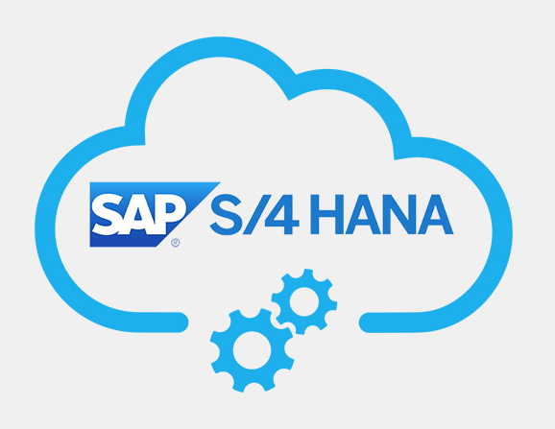
Cloud Deployment for SAP S/4HANA
SAP S/4HANA is an intelligent, next-generation ERP suite that leverages in-memory computing to streamline business processes.
Cloud deployment of S/4HANA is increasingly popular due to its flexibility, scalability, and ability to support digital transformation.

Slide 4
Cloud Deployment types in SAP S/4HANA
On-Premise
Fully controlled by the customer
Traditional ECC replacement
Annual upgrades
High customization possible
Public Cloud (SaaS - Software as a Service)
Offered as SAP S/4HANA Cloud, public edition
SAP manages infrastructure and updates
Quarterly innovation updates
Standardized processes with limited customization
Suitable for new implementations or fast-growing businesses (e.g., GROW with SAP)

Slide 5
Continued…
Private Cloud (IaaS + PaaS)
Offered via RISE with SAP (Private Edition)
Hosted on hyperscalers (AWS, Azure, GCP)
More control than public cloud
Supports legacy customizations and extensions
Ideal for existing ECC customers transitioning to S/4HANA
Hybrid Cloud
Combination of SAP S/4HANA on-premise and cloud environments
Useful during migration phase or for regulatory segregation
Requires robust integration and orchestration

Slide 6
SAP HANA Enterprise Cloud (HEC)
Description
A fully managed private cloud solution where SAP hosts and manages S/4HANA on dedicated infrastructure (SAP data centers or hyperscalers). It operates as an Infrastructure-as-a-Service (IaaS) model with managed services.
Characteristics
Offers maximum control over hardware, infrastructure, and software configurations.
Supports complex, customer-specific landscapes, including non-S/4HANA SAP solutions.
Flexible service offerings, including upgrades, backups, and monitoring, managed by SAP or partners.
Bring Your Own License (BYOL) model for SAP software.
Best Suited For
Enterprises with highly customized SAP landscapes, stringent security requirements, or those needing tailored environments.

Slide 7
Key Considerations for S/4HANA Cloud Deployment
Data Migration
Plan for seamless migration of legacy data to the cloud, using tools like SAP Data Services.
Integration
Ensure compatibility with existing systems (e.g., CRM, SCM) via SAP Integration Suite or third-party middleware.
Customization vs. Standardization
Public cloud limits customization, while private cloud offers more flexibility but at higher costs.
Security
Implement robust identity management, encryption, and monitoring to protect sensitive ERP data.
Vendor Lock-In
Evaluate multi-cloud strategies to avoid dependency on a single provider.
Performance
Optimize infrastructure (e.g., SAP HANA-certified instances on AWS/Azure) for in-memory computing demands.

Slide 8
Additional Concepts Related to SAP S/4HANA Cloud Deployment
Concept | Explanation
SAP Activate | Implementation methodology for cloud and on-premise deployments
RISE with SAP | A business transformation-as-a-service offering bundling S/4HANA, BTP, tools, and infrastructure
GROW with SAP | Targeted at mid-market customers for faster cloud ERP adoption
SAP BTP (Business Technology Platform) | Used for side-by-side extensions, analytics, and integration in cloud deployments
Clean Core | Strategy in cloud deployments to minimize custom code and use standardized extensions (via BTP)

Slide 9
Challenges and Mitigation Strategies
Challenge: High initial migration costs.
Mitigation: Use SAP’s RISE with SAP program for a structured migration path with predictable costs.
Challenge: Skill gaps in cloud and S/4HANA expertise.
Mitigation: Invest in training or partner with certified SAP cloud consultants.
Challenge: Data security concerns.
Mitigation: Implement SAP Data Custodian and cloud provider security tools for end-to-end protection.
Challenge: Downtime during migration.
Mitigation: Adopt a phased migration approach with hybrid deployment to minimize disruptions.

Slide 10
Future Trends for S/4HANA Cloud Deployment
Rise of AI-Driven ERP
Integration of AI capabilities (e.g., SAP Joule) for predictive insights and automation.
Edge Computing
Deploy S/4HANA workloads closer to data sources for low-latency processing.
Sustainability Focus
Cloud providers and SAP are prioritizing green cloud solutions to reduce environmental impact.
Low-Code/No-Code Platforms
Use SAP BTP for rapid application development and extensions in the cloud.
Zero Trust Security
Enhanced security models for S/4HANA deployments to combat evolving cyber threats.

Slide 11
Thank you

